Slide 1
ROUTE 236 TRAFFIC STUDY Town Council Meeting August 23, 2022

Slide 2
AGENDA
Introductions
Project History
Proposed Scope and Process
Council Feedback
Nikki Conant, P.E. Senior Transportation Engineer / Project Manager
Brad Lyon, P.E., PTOE, Vice President of Transportation Engineering

Slide 3
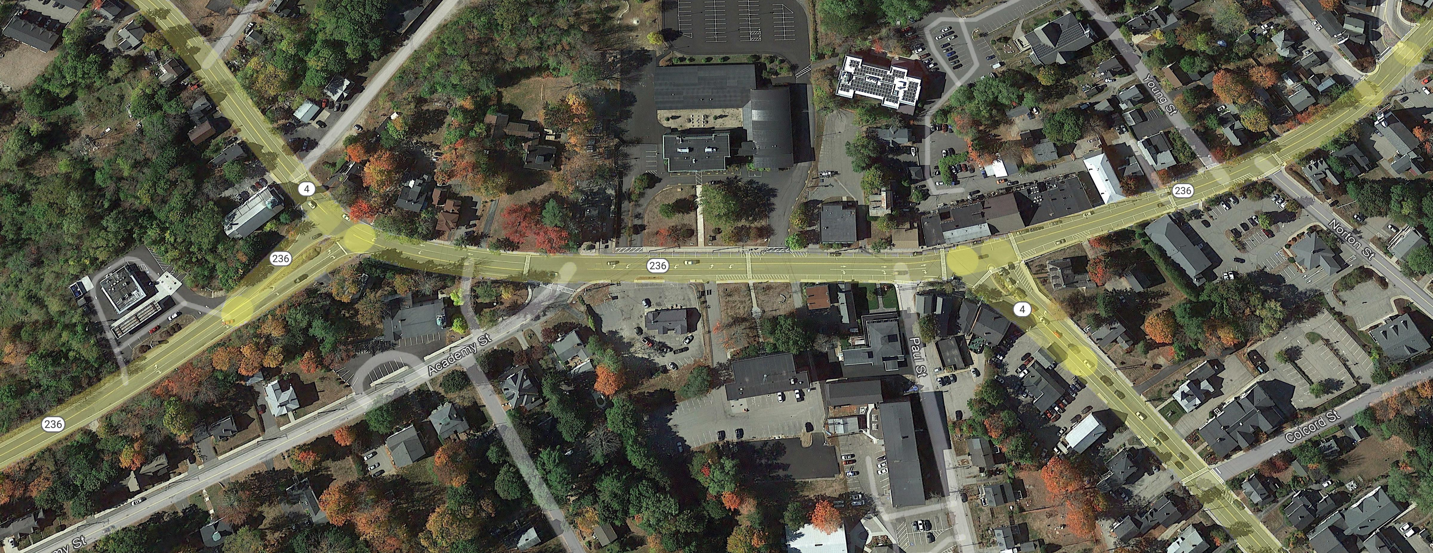
PROJECT HISTORY
Sebago completed an in-depth transportation planning study in 2010 for existing and future traffic considerations on Route 236/Route 4 from Dow Highway to Portland Street
Central Elementary School
Route 236

Slide 4
PROPOSED SCOPE AND PROCESS
Timeline
August – Kick-Off Meeting with Town Staff and Present Project to Council
September – Hold Public Meeting for Local Comment
September through December – Data Collection, Traffic Analysis, and Report Development
January – Final Report for Presentation
Goals
Update previous traffic study with near-term implementation strategies
Considerations for vehicular and pedestrian flow
Review access management strategies

Slide 5
QUESTIONS/COMMENTS

